Slide 1


EV Digital Twin: Intelligent Motor Monitoring and Anomaly Detection
Team Number: 11
Team Members:
M BHUVANESHWARI – 9924005212
VIDYASRI K S – 9924005364
RAM GOPAN G C – 9924005346
ALTHAF PAKEER MYDEEN S - 9924005467

Slide 2


INTRODUCTION
Digital Twin creates a virtual representation of a physical system.
Monitors EV motor parameters such as current, temperature, and speed.
Uses Python to process and visualise motor data.
Applies AI-based anomaly detection to identify abnormal patterns.
Integrates ESP32 telemetry and STM32 controller simulation.
Supports efficient motor monitoring and predictive maintenance research.

Slide 3

PROBLEM STATEMENT
EV motors and controllers operate under changing electrical and thermal conditions.
Abnormal current and temperature can indicate potential faults.
Traditional monitoring may not provide an integrated view of system behaviour.
A digital monitoring system can help identify abnormal patterns early.

Slide 4

OBJECTIVES
To develop a digital twin model for EV motor monitoring.
To monitor motor current, temperature, and speed.
To detect abnormal operating conditions using AI.
To visualise motor data through an interactive dashboard.
To integrate ESP32 telemetry and STM32 simulation.

Slide 5


PROPOSED SOLUTION
Develop a digital twin model for EV motor monitoring.
Collect and process motor current and temperature data.
Use AI-based anomaly detection to identify abnormal conditions.
Display real-time ESP32 telemetry and simulated data on a Python dashboard.
Integrate STM32 controller simulation using Proteus.
Support early fault identification and predictive maintenance.

Slide 6
METHODOLOGY
Data Collection: Obtain simulated EV motor data and ESP32 ADC readings.
Data Processing: Use Python and Pandas to organise motor parameters.
Digital Twin Modelling: Represent motor behaviour using simulated data.
Anomaly Detection: Classify operating data as NORMAL or ANOMALY.
Dashboard Development: Use Streamlit and Plotly to display metrics and graphs.
Embedded System: Read ADC inputs and transmit telemetry using ESP32 serial communication.
Controller Simulation: Develop and test STM32 firmware using STM32CubeIDE and Proteus.
Result Analysis: Observe motor parameters and identify abnormal patterns.

Slide 7

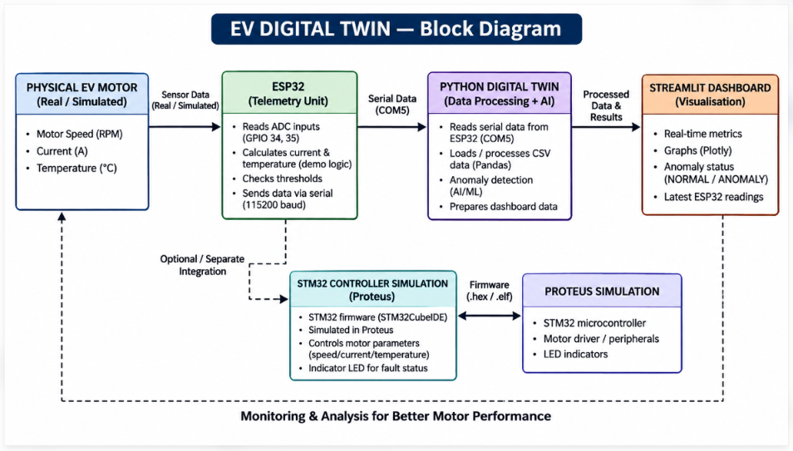
BLOCK DIAGRAM

Slide 8
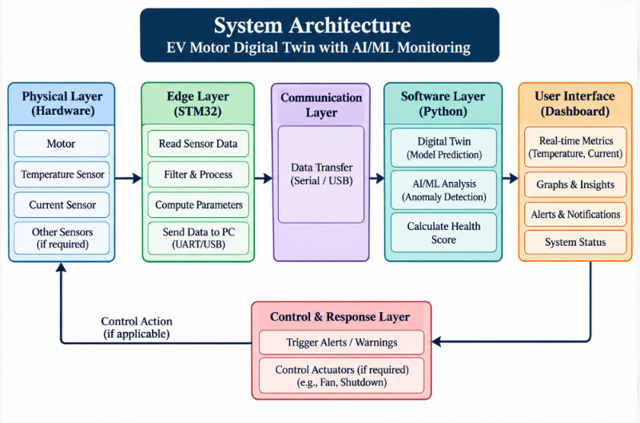
SYSTEM ARCHITECTURE

Slide 9
SOFTWARE USED
Python – Programming and data processing
Streamlit – Dashboard development
Pandas – Data handling and analysis
Plotly – Data visualisation and graphs
STM32CubeIDE – STM32 firmware development
Proteus Design Suite – Circuit design and microcontroller simulation
CSV – Storage of simulated motor data

Slide 10
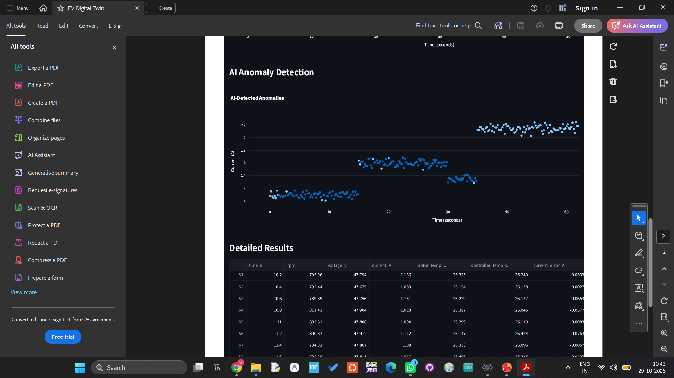
OUTPUT

Slide 11
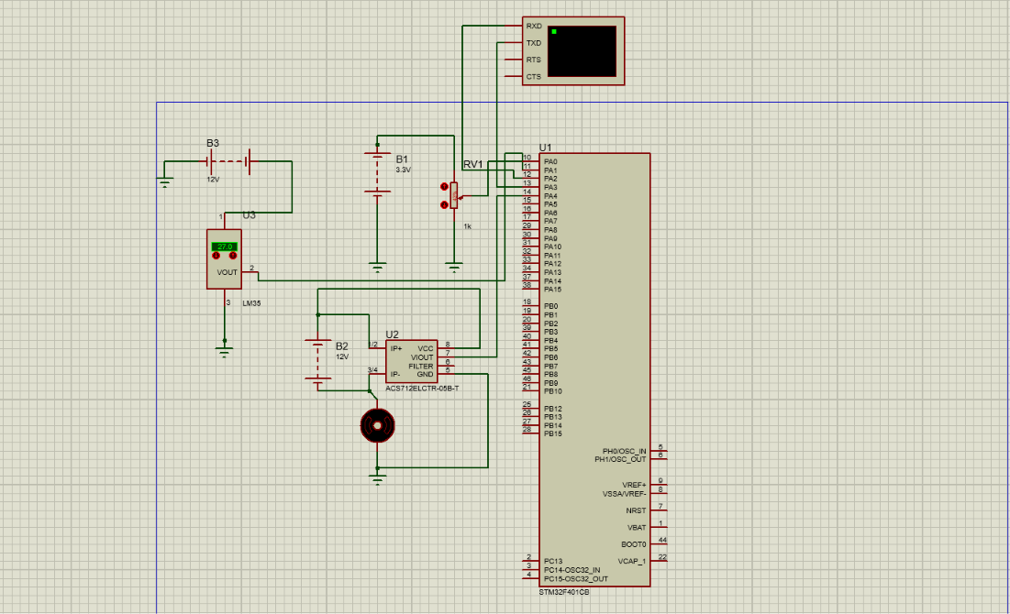
PROTEUS OUTPUT

Slide 12
APPLICATIONS
EV motor performance monitoring.
Early detection of abnormal operating conditions.
Predictive maintenance support.
Motor temperature and current analysis.
Embedded controller testing and simulation.
Smart vehicle diagnostics.

Slide 13
EXPECTED OUTCOMES
Interactive dashboard for motor parameter visualisation.
Monitoring of current, temperature, and RPM using simulated data.
AI-based classification of normal and anomalous samples.
Display of ESP32 telemetry through serial communication.
Virtual testing of embedded controller behaviour.
A foundation for future real-time EV monitoring.

Slide 14

CONCLUSION
Developed an EV Digital Twin prototype for motor monitoring.
Integrated Python, data visualisation, and anomaly detection.
Demonstrated ESP32 telemetry on the dashboard.
Established a foundation for STM32 controller simulation.
Future improvements include calibrated sensors, real motor data, and validated fault detection.

Slide 15

THANK YOU

